Slide 1
Midwest-bound
A Site Suitability Analysis of South Bend, Indiana for Relocation
by Joi Misenti
j.misenti@berkeley.edu
Geog 375--Spring 2016

Slide 2

Goal: assess 3 parameters of south bend, in
Proportion of people per locale holding Bachelor’s degrees
Average listing price of rent per locale
Distance from Notre Dame campus
South Bend, Indiana
Downtown

Slide 3
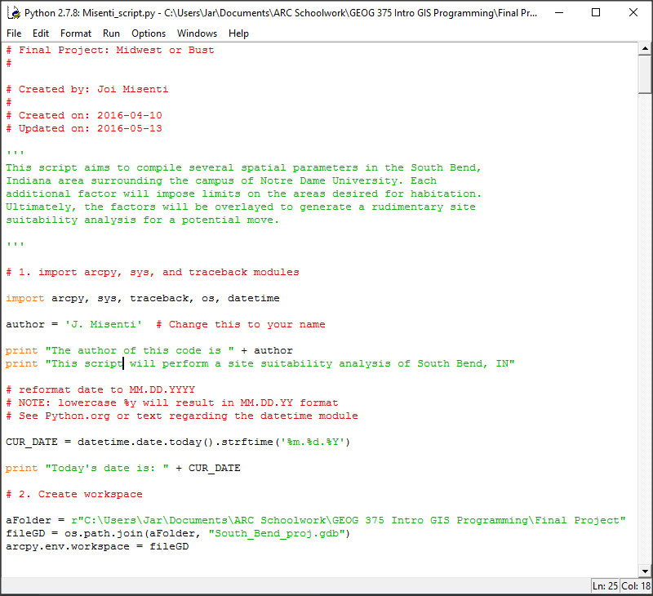
First things first
Set the basic essentials of the python script.
Import necessary modules.
Establish folder directories and workspace.

Slide 4
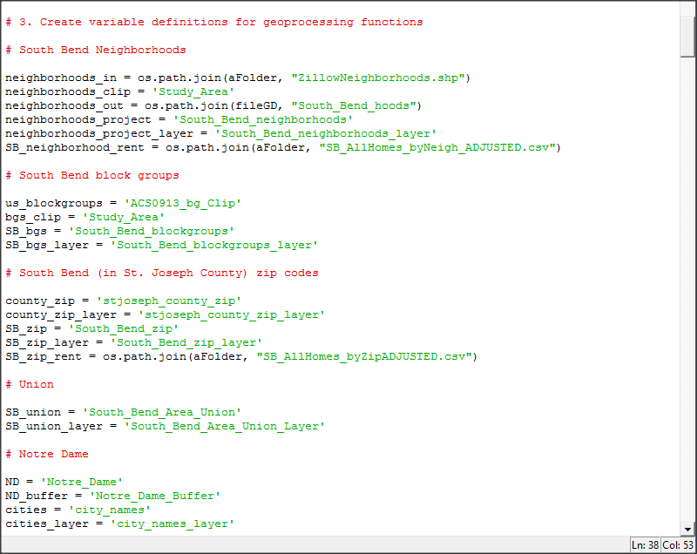
Set up variables
Grouped by the feature classes the variables are associated with.

Slide 5
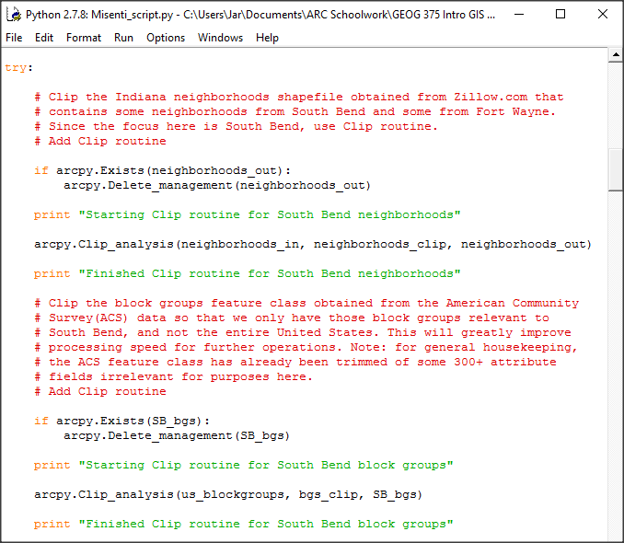
Process: clip
Clipped the neighborhoods shapefile and the block groups feature class to the study area of South Bend with special attention to areas near Notre Dame University.

Slide 6
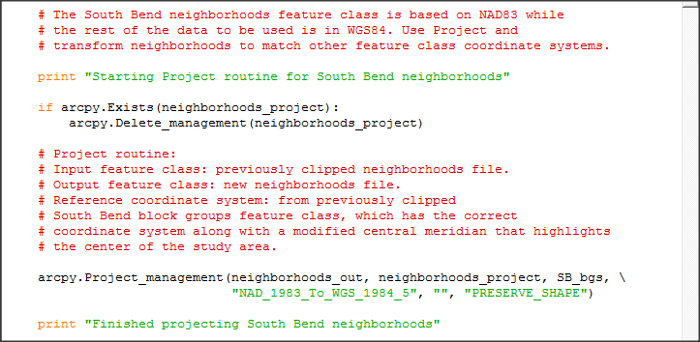
Challenge: Different Spatial Reference
Applied the Project routine to change coordinate system of neighborhoods shapefile from NAD83 to WGS84 to be in accordance with rest of feature class data.

Slide 7
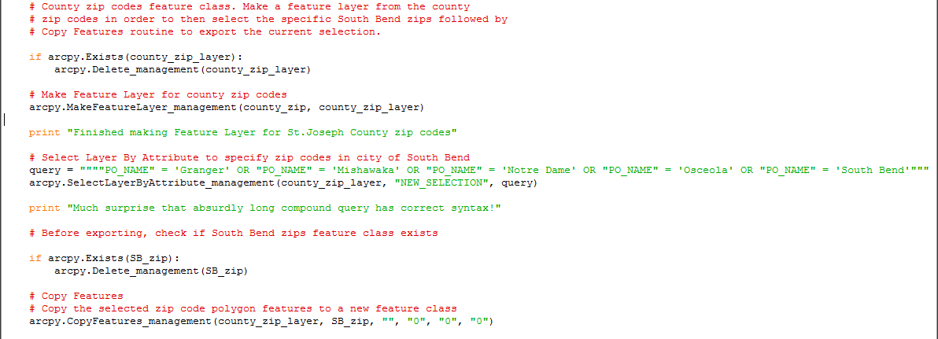
Select relevant zip codes
Made feature layer for St. Joseph County zip codes features class
Performed Select Layer by Attribute to select only those zip codes in city of South Bend
Copied the selected features to a new feature class

Slide 8
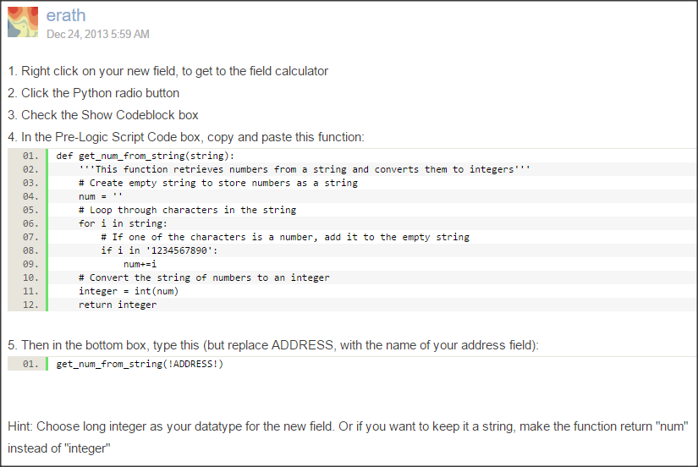
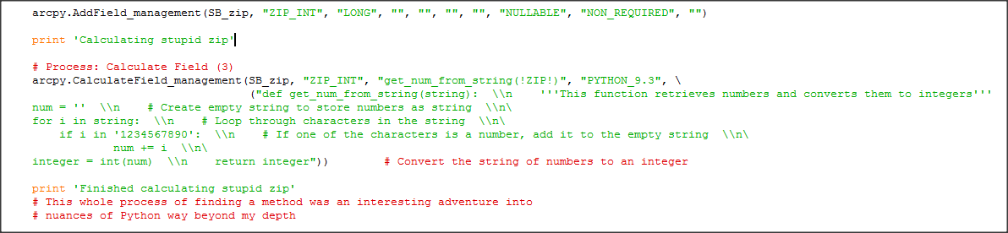
Super challenge: Converting String Field To Integer Field for Zip Codes
Failed Joins because the field being joined on is string data type in one file and integer in the other. Code (at right) found in Esri thread at: https://geonet.esri.com/thread/86096
Formatting this code into my script (at bottom) was a difficult process since I was unsure of proper syntax for wrapping lines in mid-argument. By trial-and-error I think I found a makeshift solution.

Slide 9
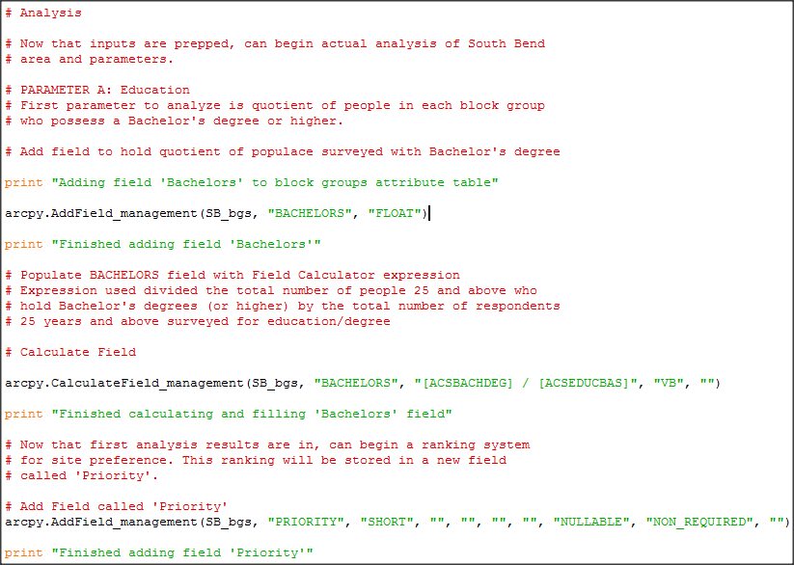
Add fields & Calculate Fields
Add field “BACHELORS” to hold the proportion of people over 25 years of age per block group holding bachelors degrees
Calculate Field to populate records with equation: # respondents with Bachelors or higher divided by all respondents for education
Add field “PRIORITY” to update with successive queries for preferential sites

Slide 10
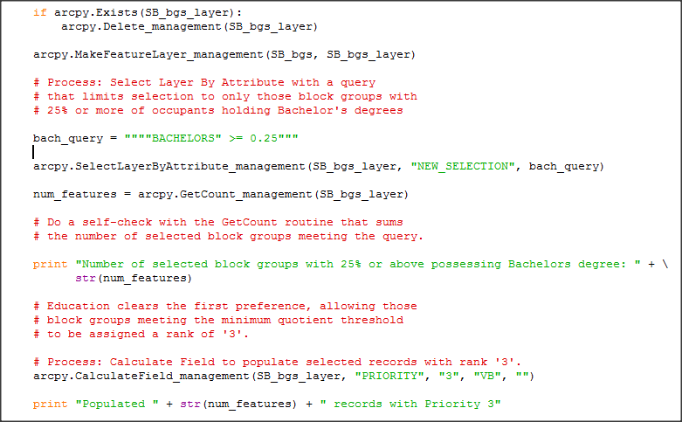
Query for threshold proportion of Bachelors
Select by Attribute for block groups containing proportion of people with Bachelors greater than 0.25
Calculate Field to populate Priority with ‘3’ for block groups meeting query selection

Slide 11
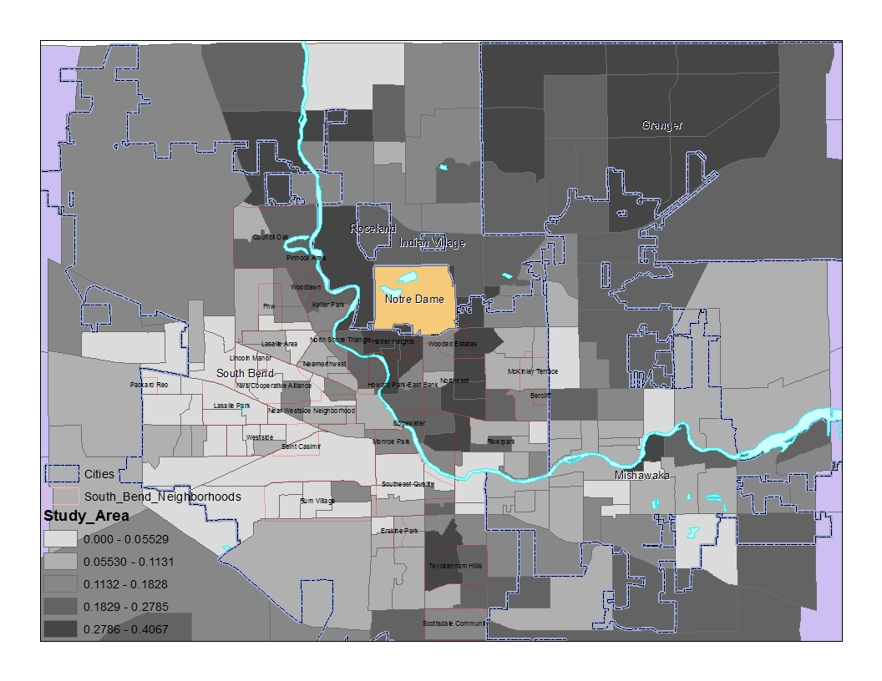
Bachelors quotient map
This map shows the polygons symbolized according to proportion of people holding Bachelors with the darker polygons indicating a higher proportion of people.
In general, the trend seems to indicate higher percentages of Bachelors to the North and Northeast for some reason.

Slide 12
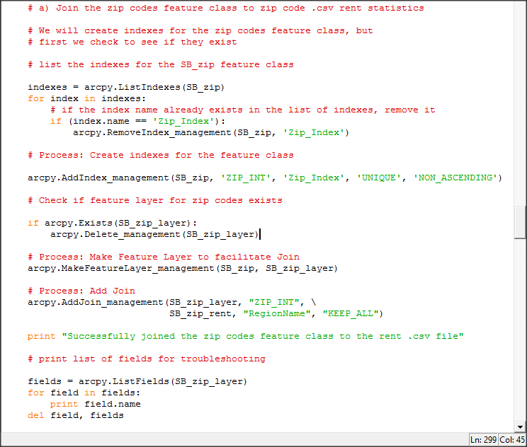
Process: add join
Create Indexes, make a Feature Layer, and Add Join
List Fields for troubleshooting
This process was done to connect the csv rent files with the respective feature classes for both zip codes and neighborhoods

Slide 13
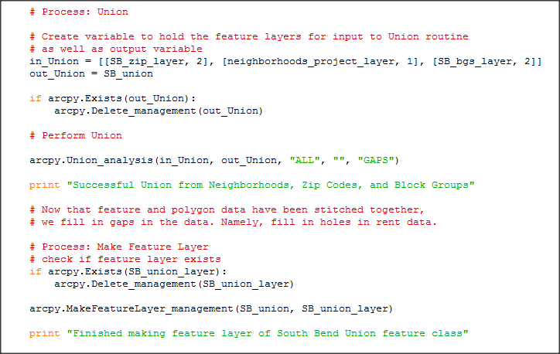
Process: Union
Defined variable to hold feature class list that will input to Union.
Perform Union to fill in gaps between neighborhoods layer with existing information from other layers
- This conveniently brings all the information into one layer for analysis
Make feature layer for Union feature class for further routines and queries

Slide 14
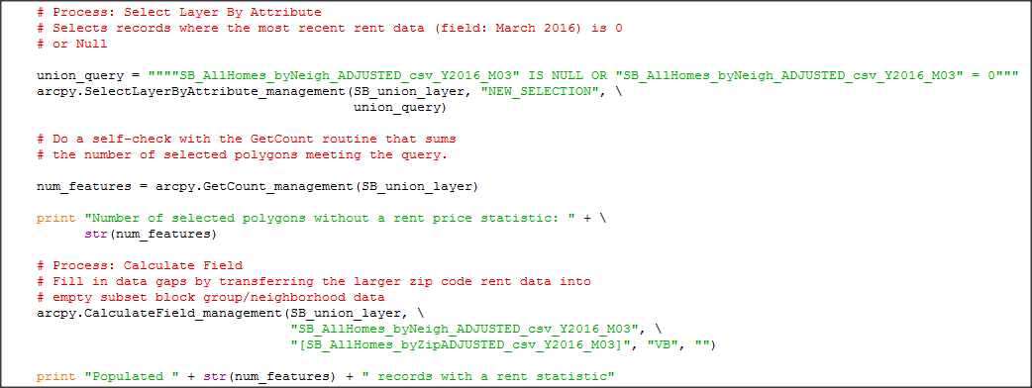
Transfer rent statistics
Due to Union, some newly associated neighborhood polygons lack rent statistic. This can be rectified by
transferring the rent values from the larger, encompassing zip code polygon rent statistic.

Slide 15
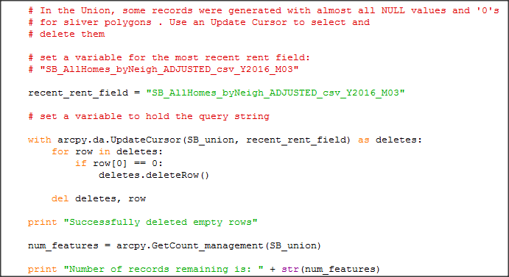
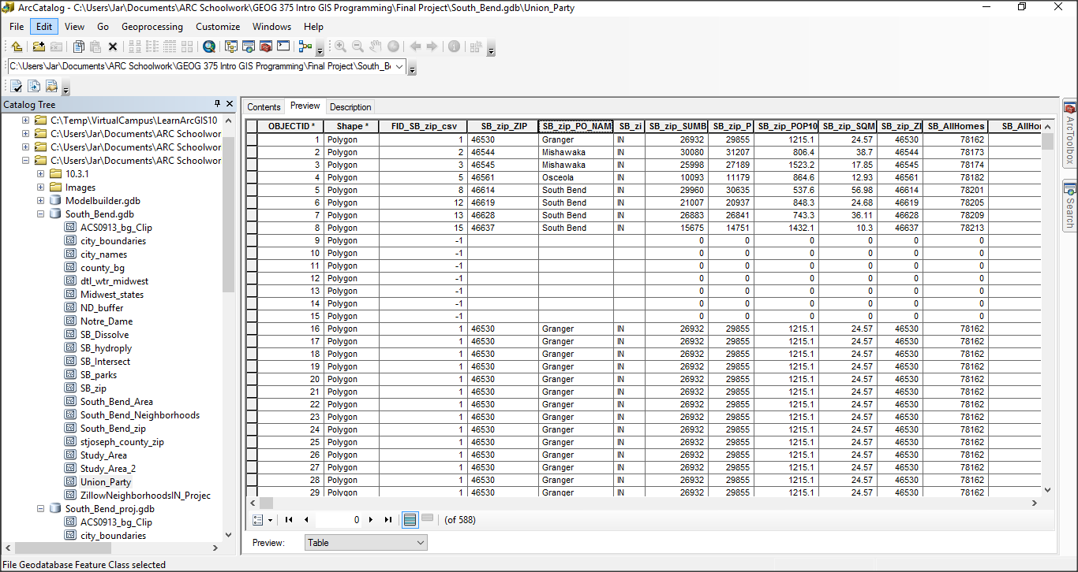
Update cursor: Delete Records
Due to Union, some sliver polygons were created that are of no consequential to analysis. These were Deleted with Update Cursor.
Sliver polygons

Slide 16
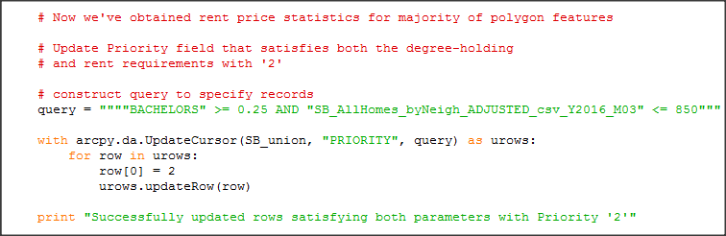
Update cursor: Update Priority Field
Define variable that holds query for both parameters satisfying education (> = 0.25) and rent maximum (<= $850)
Use Update Cursor to update records in Priority field satisfying the query with priority ‘2’

Slide 17
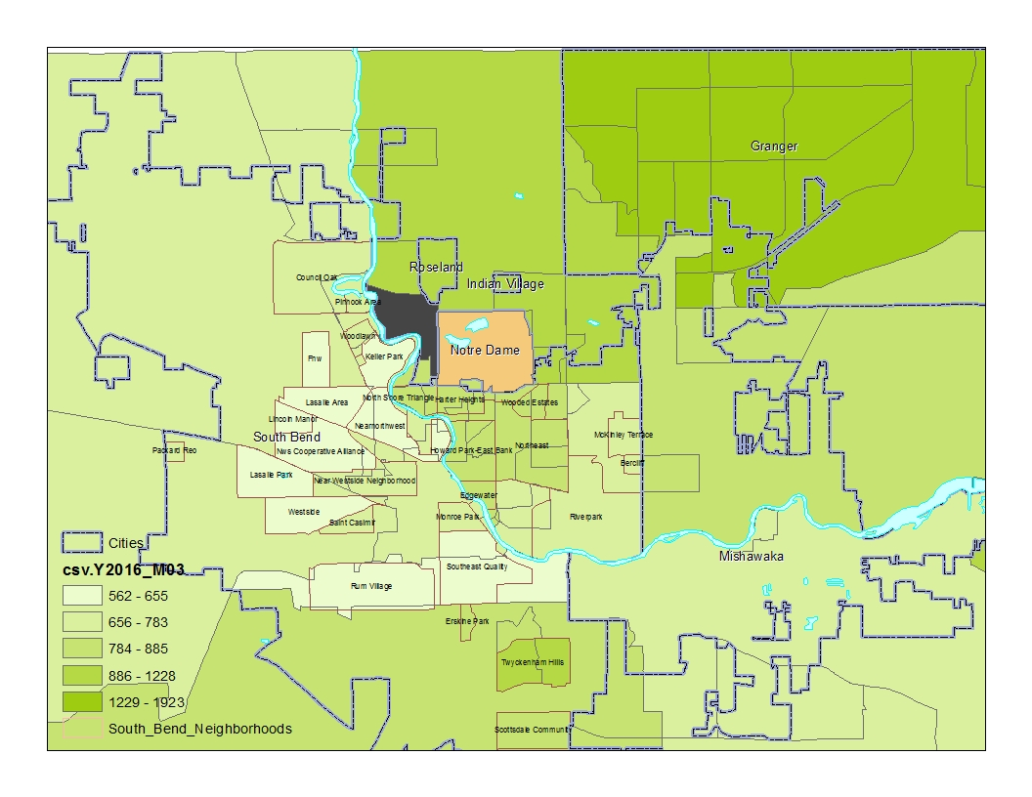
Rents map
This map shows the rent ranges for each polygon. The rent statistic is a monthly average for June 2016 for single-family residences, condos, and co-ops.
There seems to be an increasing trend towards the northern and southern periphery of South Bend city proper.

Slide 18
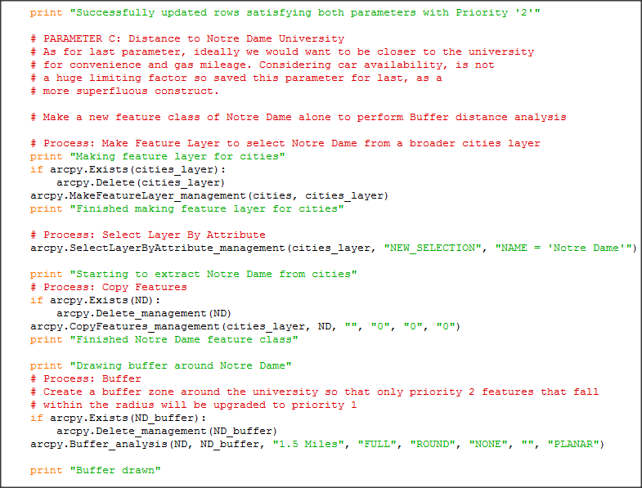
Notre dame extraction
Isolate Notre Dame as a solitary feature class from cities
Create a buffer with 1.5 mile radius around the campus

Slide 19
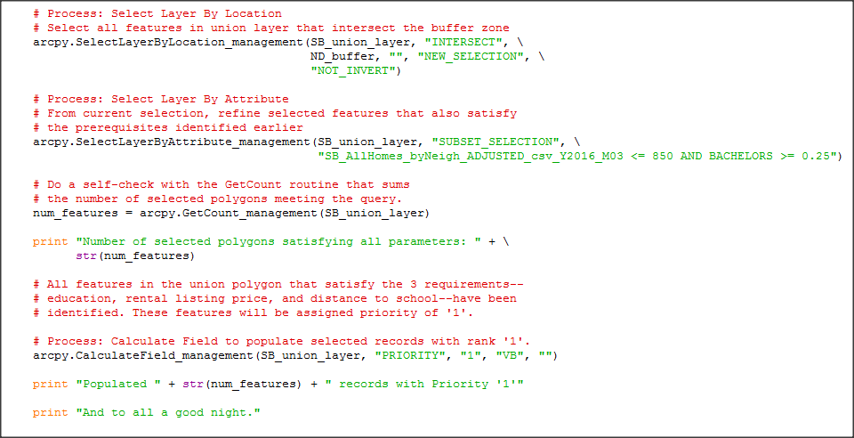
Final priority ranking update
Select those polygons that satisfy all 3 queried parameters
Populate the Priority field with ‘1’ to indicate that these are the final polygons that meet our specifications

Slide 20
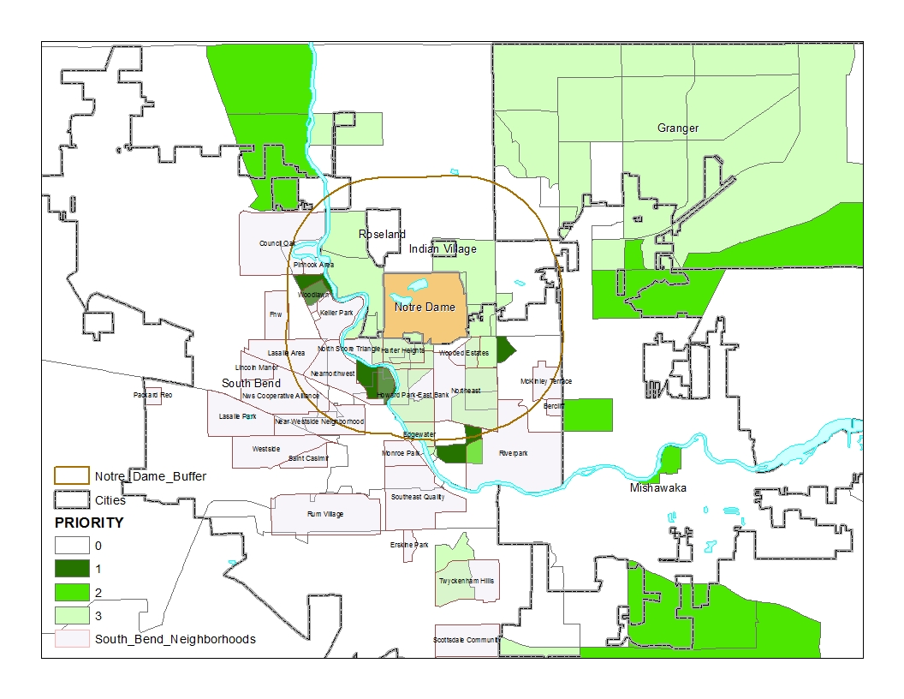
Final map
The resulting priority map. Darker green indicates higher priority.
There seem to actually be a few polygons near Notre Dame that meet my criteria.

